Slide 1
Conversion of Existing Nitrogen Plants for Medical Oxygen Generation
04 May, 2021

Slide 2
Background
CPCB has discussed with nearly 400 industries having nitrogen plants and identified 41 industries, wherein existing nitrogen plants may be spared for producing oxygen, without affecting their normal operation.
Detailed discussions have been held with the industries and representatives from SPCBs, IOCL, PESO, All India Gas Manufacturers Association, DRDO and experts from M/s UPL Ltd, where one such plant has already been converted to produce oxygen, also participated in the meeting.

Slide 3
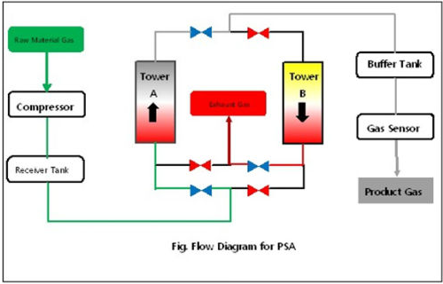
PSA Technology: Operation Philosophy
Pressure Swing Absorption (PSA)
Configuration of Oxygen Generation Plant
Compressor for generating the pressure of feed air at 6 bar
Towers : filled with Alumina (water removal) & Zeolite Molecular Sieve
Each tower working for 45 sec for generation of O2/N2 and 15 sec for re-generation
Gas sensor for continuous monitoring of O2 or N2 quality at supply side
Discharge O2 or N2 at constant pressure of 4.5 bar
Key Elements for conversion:
Change of catalyst from Carbon Molecular Sieve (CSM) into Zeolite Molecular Sieves (ZMS)
Requirement of Compressor
Oxygen analyser
Approximately 1 TPD of oxygen can be produced by converting a nitrogen plant of 100 Nm³/hr capacity using ZMS
Nearly 1,000 kg of ZMS is required for conversion of 100 Nm3/hr capacity nitrogen plant
ZMS costs nearly INR 700-900/kg
Lithium based sieve cost about INR 2,000 /kg but 50% more efficient than ZMS
Pressure Swing Absorption (PSA)

Slide 4
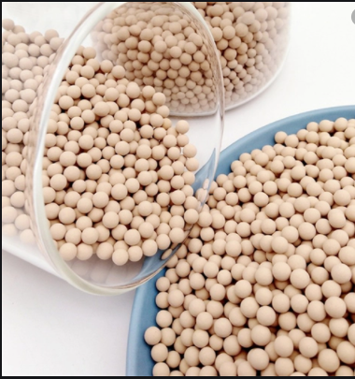
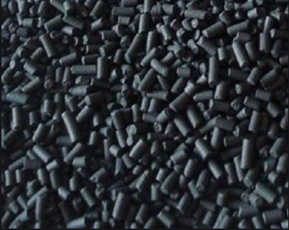
Type of Molecular Sieve & Usage
O2 Generation: Zeolite Molecular Sieve
N2 Generation: Carbon Molecular Sieve

Slide 5
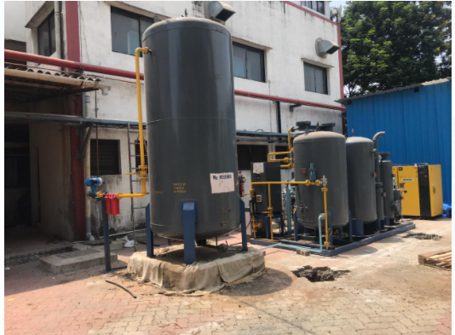
Nitrogen Plant converted to oxygen plant by M/s. UPL Ltd. and installed at LG Rotary Hospital, Vapi (Gujarat)
Installed within 72 hours and inaugurated on 27.04.2021

Slide 6
Industries identified for producing oxygen for medical use by converting nitrogen plants (1/5)
A. Plants that can be shifted to nearby hospitals
Sr. No. | Company / Plant Name | District/ State | Capacity of N2 Plant (Nm3/hr) | Potential O2 generation capacity (TPD) | Zeolite Requirement (tons) | Remarks
1 | UPL Limited, Unit 0 | Valsad, Gujarat | 50.0 | 0.5 | 0.5 | 17 out of 30 industries from Sl. No. 1 to 30, have placed orders for Zeolite Molecular Sieve with BASF, Germany and remaining industries will place order within a day or two after ascertaining specifications
2 | UPL Limited, Unit-1 | Bharuch, Gujarat | 30.0 | 0.3 | 0.3
3 | UPL Limited, Unit-2 | Bharuch, Gujarat | 60.0 | 0.6 | 0.6
4 | UPL Limited, Unit-5 | Bharuch, Gujarat | 200.0 | 2.0 | 1.4
5 | Wellknown Polyester Ltd. | Daman, Daman & Diu | 50.0 | 0.50 | 0.5
6 | Hilti Mfg. India Pvt. Ltd – I | Navsari Gujarat | 25.0 | 0.25 | 0.25
7 | M/s. Aurobindo Pharma | Vishakhapatnam, Andhra Pradesh | 75.0 | 0.75 | 0.75
8 | M/s Aurobindo Pharma | Hyderabad, Telangana | 25.0 | 0.25 | 0.25
9 | Lonsen Kiri Chemical Industries | Vadodara, Gujarat | 300.0 | 3.0 | 8.8

Slide 7
Industries identified for producing oxygen for medical use by converting nitrogen plants (2/5)
A. Plants that can be shifted to nearby hospitals
Sr. No. | Company / Plant Name | District/ State | Capacity of N2 Plant (Nm3/hr) | Potential O2 generation capacity (TPD) | Zeolite Requirement (tons) | Remarks
10 | Deccan Fine Chemicals | Vishakhapatnam, Andhra Pradesh | 100.0 | 1.0 | 1.0 | 17 out of 30 industries from Sl. No. 1 to 30, have placed orders for Zeolite Molecular Sieve with BASF, Germany and remaining industries will place order within a day or two after ascertaining specifications
11 | Bhilosa Industries Pvt Ltd, Silvassa | Silvasa, Dadra Nagar Haveli | 200.0 | 2.0 | 1.8
12 | HPL Additives Ltd. | Palwal, Haryana | 40.0 | 0.4 | 0.3
13 | Mylan Labs | Vishakhapatnam, Andhra Pradesh | 100.0 | 1.0 | 1.0
14 | Aegis Logistics Ltd. | Chembur, Maharashtra | 150.0 | 1.5 | 0.9
15 | Sun Pharmaceutical | Panoli, Gujarat | 60.0 | 0.6 | 0.6
16 | Sun Pharmaceutical | Chennai, Tamil Nadu | 20.0 | 0.2 | 0.2
17 | Sun Pharmaceutical | Malanpur, Madhya Pradesh | 100.0 | 1.0 | 1.0
18 | Sun Pharmaceutical | Devas, Madhya Pradesh | 75.0 | 0.75 | 0.75
19 | Sun Pharmaceutical | Ahmednagar, Maharashtra | 20.0 | 0.2 | 0.2

Slide 8
Industries identified for producing oxygen for medical use by converting nitrogen plants (3/5)
A. Plants that can be shifted to nearby hospitals
Sr. No. | Company / Plant Name | District/ State | Capacity of N2 Plant (Nm3/hr) | Potential O2 generation capacity (TPD) | Zeolite Requirement (tons) | Remarks
20 | Bharat Rasayan Ltd | Dahej, Gujarat | 50.0 | 0.5 | 0.5 | 17 out of 30 industries from Sl. No. 1 to 30, have placed orders for Zeolite Molecular Sieve with BASF, Germany and remaining industries will place order within a day or two after ascertaining specifications
21 | Insecticide India Ltd | Dahej, Gujarat | 50.0 | 0.5 | 0.5
22 | Shiva Pharmachem Ltd. | Padra, Gujarat | 15.0 | 0.15 | 0.15
23 | Indo Amines Ltd | Tundav, Gujarat | 20.0 | 0.2 | 0.2
24 | Metrochem Pharma | Andhra Pradesh | 100.0 | 1.0 | 1.0
25 | Ganesh Polychem (div. of Aarti Ltd..) | Vapi, Gujarat | 100.0 | 1.0 | 1.0
26 | Ganesh Polychem (div. of Aarti Ltd..) | Tarapur, Maharashtra | 200.0 | 2.0 | 2.0
27 | Aarti Industries (Org.div.) | Vapi, Gujarat | 25.0 | 0.25 | 0.25
28 | Valentis Laboratories | Pashamylaram, Telangana | 40.0 | 0.4 | 0.4
29 | Siemens Pvt. Ltd. | Verna, Goa | 150.0 | 1.5 | 1.5
30 | Transpek Industry Ltd | Vadodara, Gujarat | 50.0 | 0.5 | 0.5

Slide 9
Industries identified for producing oxygen for medical use by converting nitrogen plants (4/5)
A. Plants that can be shifted to nearby hospitals
Sr. No. | Company / Plant Name | District/ State | Capacity of N2 Plant (Nm3/hr) | Potential O2 generation capacity (TPD) | Zeolite Requirement (tons) | Remarks
31 | Bayer Crop Science Vapi | Vapi, Gujarat | 200.0 | 2.0 | 2.0 | They have been requested to commence conversion work in a meeting held on 03.05.2021
32 | Cheminova Ltd. Panoli, Bharuch, Gujarat | Panoli, Gujarat | 30 | 0.3 | 0.3
33 | Deepak Nitrite Ltd., Chhani Jakatnaka, Vadodara, Gujarat | Vadodara, Gujarat | 40 | 0.4 | 0.4
34 | Colourtex Industries Pvt Ltd., Pandesara GIDC, Udhna, Surat, Gujarat | Surat, Gujarat | 250 | 2.5 | 2.5
35 | M/s Dalas Biotech, Bhiwadi, Rajasthan | Alwar, Rajasthan | 50 | 0.5 | 0.5
36 | Pawan Putra Wafers Pvt., Boranada, Rajasthan | Jodhpur, Rajasthan | 90 | 0.9 | 0.9
37 | Kansara Forge & Wires, Boranada Industrial area, Jodhpur, Rajasthan | Jodhpur, Rajasthan | 20 | 0.2 | 0.2
38 | Inventys Research Company Pvt Ltd., MIDC, Buti Bori, Nagpur, Maharashtra | Nagpur, Maharashtra | 15 | 0.15 | 0.15
Total (A) |  |  | 3,175 | 31.75 | 36.05

Slide 10
Industries having capacity to generate oxygen for medical use (5/5)
B. Plants that can produce oxygen on-site
Sr. No. | Company / Plant Name | District/ State | Capacity of N2 Plant (Nm3/hr) | Potential O2 generation capacity (TPD) | Zeolite Requirement (tons) | Remarks
39 | Raichem Medicare Pvt. Ltd. | Raichur, Karnataka | 125.0 | 1.3 | 1.3 | Plant Installation: In progress ZMS Procurement: In progress
40 | Orchid Pharma Limited | Chennai, Tamilnadu | 190.0 | 1.9 | 1.9 | Plant Installation: In discussion with OEMs/ vendors ZMS Procurement: In discussion with OEMs/ vendors
41 | Jindal Saw | Bhilwara, Rajasthan | 600.0 | 6.0 | 6.0 | In discussion with OEMs/ vendors
Total (B) |  |  | 915.0 | 9.2 | 9.2
C. Plants having surplus oxygen which can be filled in cylinders and used for medical purpose
42 | Chennai Petroleum Corporation Ltd. (Formerly Madras Refineries Ltd.) | Chennai, Tamil Nadu | - | 3.4 | - | High Pressure Compressor to be procured and PESO clearance required
43 | Tamil Nadu Newsprint and Papers Limited | Karur, Tamil Nadu | - | 4.0 | - | High Pressure Compressor to be procured and PESO clearance required
Total (C) |  |  |  | 7.4
Total (A, B and C) |  |  | 4,090.0 | 48.35 | 45.25

Slide 11
Summary of industries identified for generating oxygen for medical use by converting nitrogen plants
No. of Plants | Capacity of N2 Plant (Nm3/hr) | Potential O2 generation capacity (TPD) | Zeolite Requirement (tons)
A. Plants that can be shifted to nearby hospitals
38 | 3,175 | 31.75 | 36.05
B. Plants that can produce oxygen on-site
3 | 915 | 9.2 | 9.2
C. Plants that can produce oxygen on-site and has surplus oxygen
2 | - | 7.4 | -
Total (A+B+C)
43 | 4,090 | 48.35 | 45.25

Slide 12
Cost of conversion of N₂ plants to O₂ plants (source: UPL Ltd.)
Amt. in INR
Sl. No. | Description | 50 Nm³/hr N₂ capacity plant | 200 Nm³/hr N₂ capacity plant
01. | ZMS | 4,95,000 | 13,61,250
02. | Activated Alumina | 6,200 | 38,000
03. | Control Panel | 80,000 | 80,000
04. | O₂ analyzer and change over valves | 60,000 | 60,000
05. | Filters | 35,000 | 35,000
06. | Services Charges | 45,000 | 45,000
07. | Site related expenses | 50,000 | 1,00,000
 | Sub Total | 7,71,200 | 17,19,250
 | Add 10% | 77,120 | 1,71,925
 | TOTAL | 8,48,320 | 18,91,175
 | Re-conversion Cost | 2,00,000 | 2,00,000
 | GRAND TOTAL | ~ 10,50,000 | ~ 21,00,000

Slide 13
Estimated Costs
Estimated Cost for Conversion of existing Nitrogen Plant for Medical Oxygen Production
Size of N2 Plant (Nm3/h) | Total for Conversion for per Ton per Day oxygen generation capacity (TPD) INR Lakh per TPD
50 – 100 | 10-15
100 – 150 | 15-18
Upto 200 | 18-21
Estimated Cost Components
Company | Estimated Cost (INR)
ZMS | INR 700-900/kg
Miscellaneous Cost | 35-40% for Plant upto 100 Nm3/hr 20-25% for Plant upto 200 NM3/hr
Reconversion Cost | Upto Rs 2,00,000 per plant
Compressor (required for cylinders filling at on-site plants only) | Rs 30-50 lakh for High Pressure Compressor
Total estimated cost of conversion for 33 identified plants | ~ INR 4 - 5 crore

Slide 14
Challenges
    Procurement of Zeolite Molecular Sieve (ZMS) – to be imported, may require 3-4 weeks.
    17 industries have placed orders placed with BASF – airlifting from Germany to expedite delivery
    Others are in process of placing order – will need help in airlifting ZMS
High Pressure Compressors for on-site oxygen production - to be imported, may require 4-6 weeks
Facilitate airlifting to expedite delivery
Approval of Petroleum and Explosive Safety Organization (PESO) in case of On-Site production

Slide 15
Thank You

