Slide 1
Conversion of PSA based Nitrogen Plant to Oxygen Generation
(An installation by M/s UPL at L G Rotary Hospital, Vapi)

Slide 2
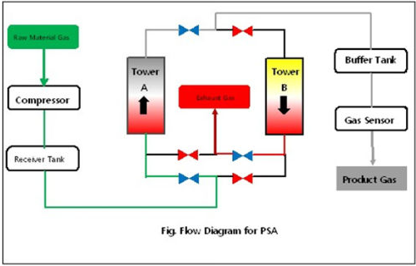
PSA Technology: Operation Philosophy
Compressor for generating the pressure of feed air at 6 barg
Tower A & B : filled with Alumina (water removal) & Molecular sieve
Each tower working for 45 sec for generation of O2/N2 and 15 sec for re-generation
Buffer tank to maintain the constant pressure at supply side during change over
Gas sensor for continuous monitoring of O2 or N2 quality at supply side
Discharge O2 or N2 at constant pressure of 4.5 barg

Slide 3
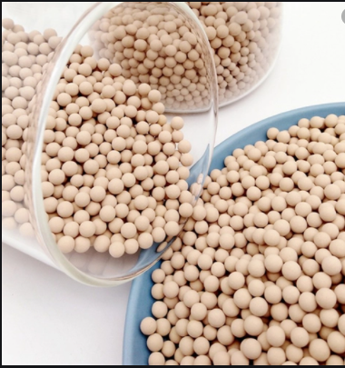
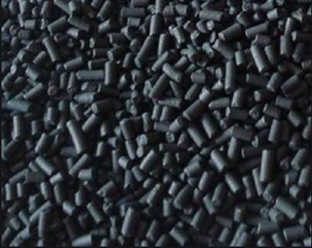
Type of Molecular Sieve & Usage
O2 Generation: Zeolite Molecular Sieve
N2 Generation: Carbon Molecular Sieve

Slide 4
List of Modification : From Nitrogen to Oxygen Generation
Molecular Sieve Changer over from Carbon to Zeolite & Activated Alumina
Oxygen analyser for quality monitoring
2 stage filter for dust removal at outlet (1 micron and 0.1 micron)
Control Panel program modification/ replacement
On-Off valve installation for automatic change over
Limitation of N2 Plant to O2 Production
Spare Nitrogen Plant availability at Industry
Nitrogen or Oxygen can be produce at one time and can’t change over without above modification

Slide 5
Oxygen Capacity that can be generated from different Capacity Nitrogen Plants

Slide 6
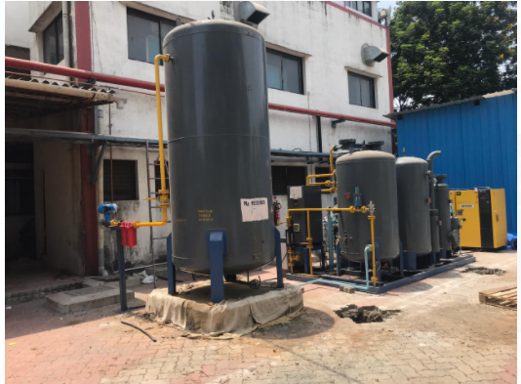
Vapi Installation by UPL @ L G Rotary Hospital, Vapi
Installed within 72 hours by team of UPL and more work is in progress

